Slide 1
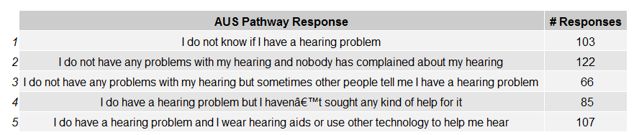
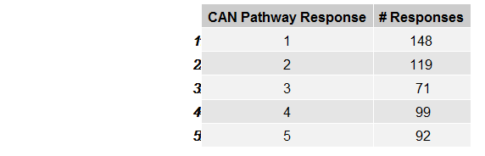
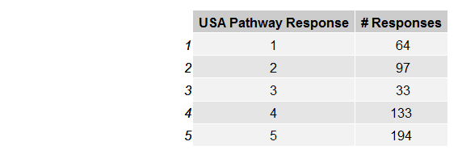

In person survey counts (city)
Sydney
Toronto
Seattle
London

Slide 2












Pathway 1
I do not know if I have a hearing problem
I do not have any problems with my hearing
and nobody has complained about my hearing
I do not have any problems with my hearing
but sometimes other people tell me I have a hearing problem
Pathway 2
I do have a hearing problem but have not sought any help for it
Pathway 3
I do have a hearing problem and I wear hearing aids or use other
technology to help me hear
All gender
Male
Female
Seattle, USA
London, UK
Toronta, CAN
Sydney, AUS

Slide 3








Country-Panel surveys
Pathway 1
I do not know if I have a hearing problem
I do not have any problems with my hearing
and nobody has complained about my hearing
I do not have any problems with my hearing
but sometimes other people tell me I have a hearing problem
Pathway 2
I do have a hearing problem but have not sought any help for it
Pathway 3
I do have a hearing problem and I wear hearing aids or use other
technology to help me hear
Male
Female
USA
UK
CAN
AUS

Slide 4
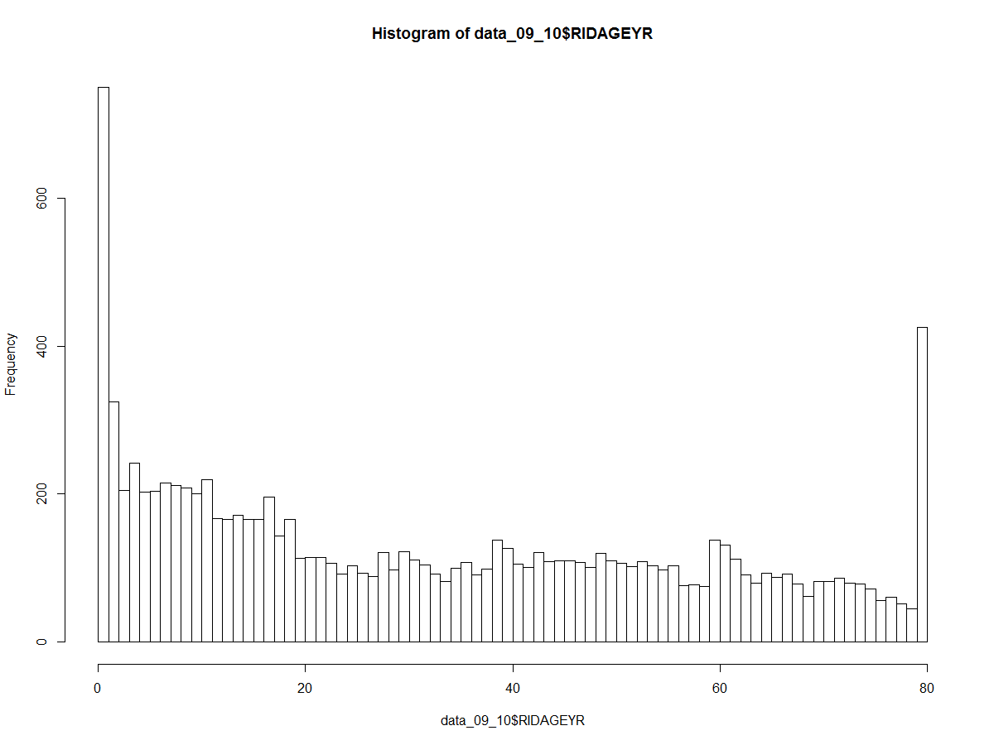
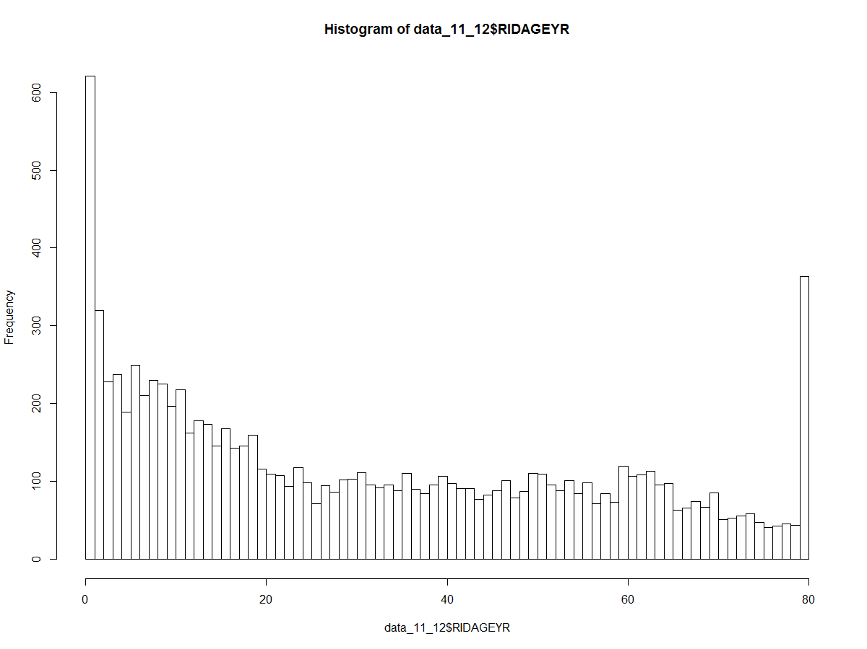
NHANES: Demographics
Age histogram for 2009-2010 and 2011-2012
n=10537
n=9756

Slide 5


NHANES: Demographics
2009-2011
2011-2012

Slide 6


NHANES: Self-report hearing
9756 -> 9364

Slide 7
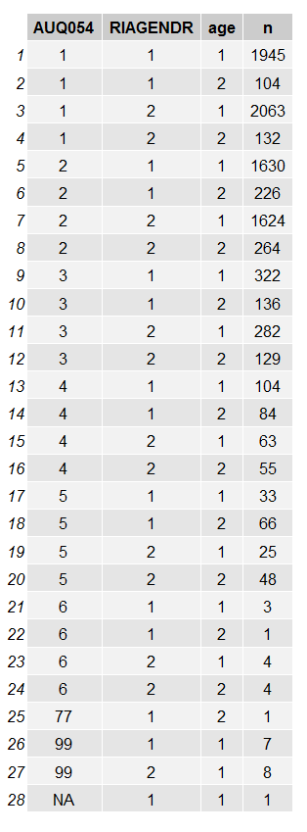
NHANES: Self-report hearing
AUQ054
1=Excellent
2=Good
3=A little trouble
4=Moderate hearing trouble
5=A lot of trouble
6=Deaf
77=refused
99=Don’t know
Gender
1=male
2=female
Age
1= <65
2= 65+

Slide 8
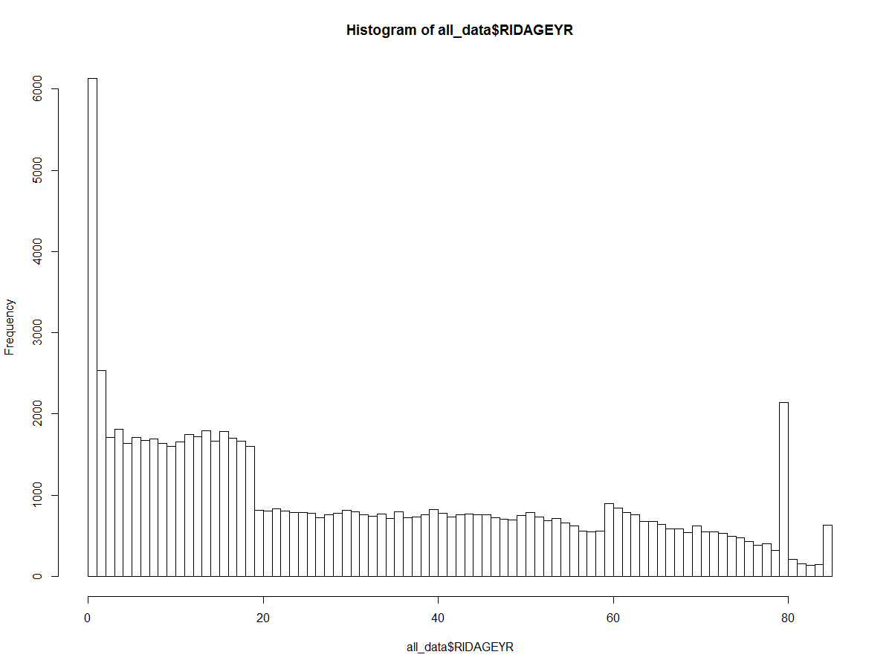
NHANES: Demographics
Age histogram for all years

Slide 9

NHANES: Demographics
All years

Slide 10
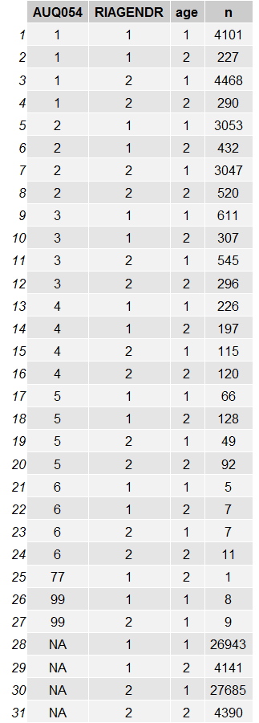
NHANES: Self-report hearing, all years
AUQ054
1=Excellent
2=Good
3=A little trouble
4=Moderate hearing trouble
5=A lot of trouble
6=Deaf
77=refused
99=Don’t know
Gender
1=male
2=female
Age
1= <65
2= 65+

Slide 11
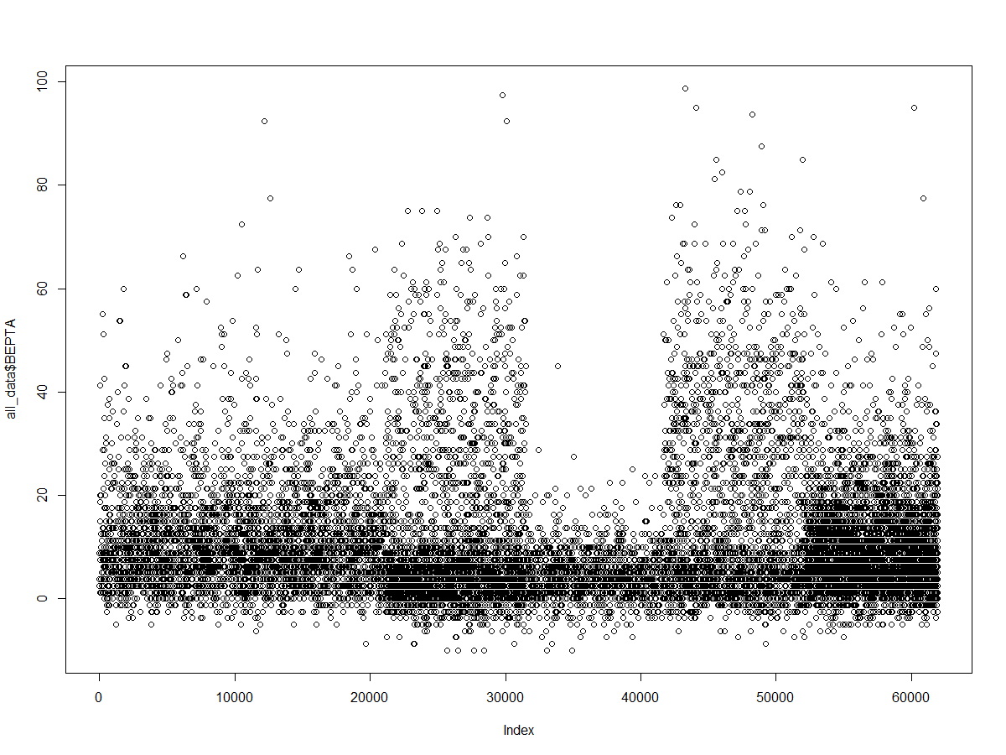
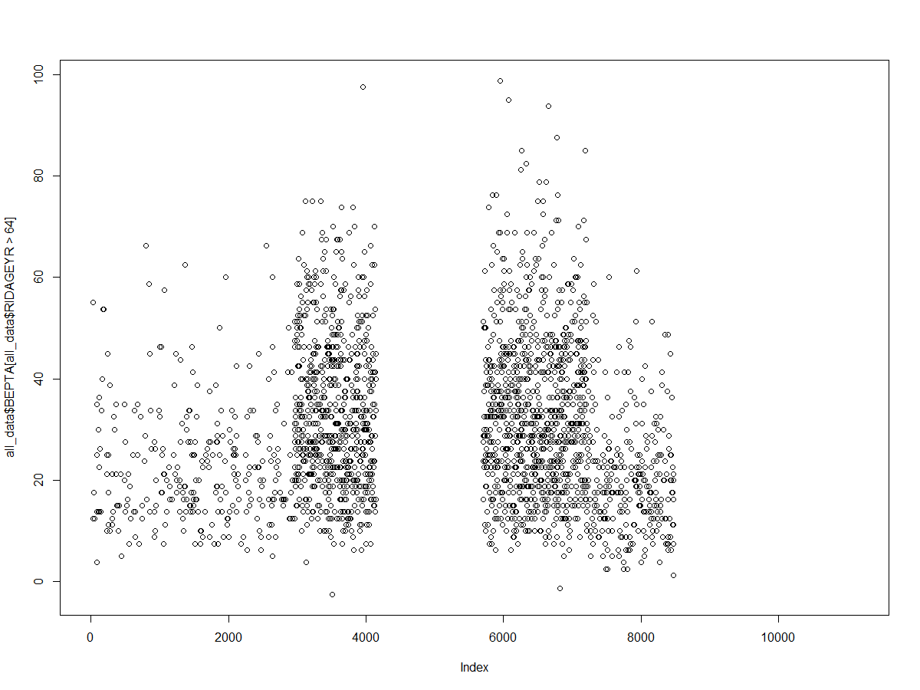
BEPTA >65 years
BEPTA all ages
n=13497
n=2226

Slide 12
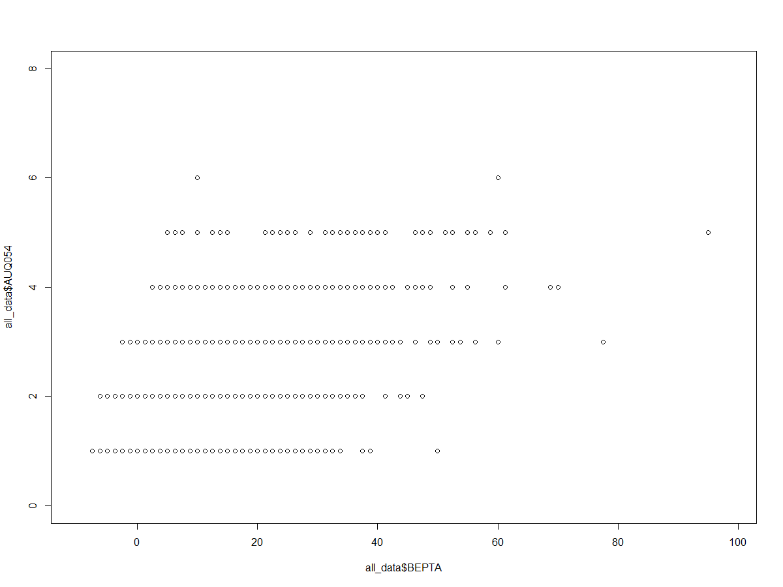

Slide 13
BEPTA model w/age as factor
lm(formula = BEPTA ~ factor(q0046) + factor(q0032, levels = c(2,
1)) + factor(q0042, levels = c(2, 1)) + factor(q0003) + factor(q0012) +
factor(q0002) + factor(man.group1$q0008, levels = c(5, 4,
3)), data = man.group1)
Residuals:
Min 1Q Median 3Q Max
-34.952 -6.406 -0.154 6.104 36.906
Coefficients:
Estimate Std. Error t value Pr(>|t|)
(Intercept) 17.7973 13.0219 1.367 0.173079
factor(q0046)2 -3.0628 2.6210 -1.169 0.243823
factor(q0046)3 1.0049 3.7091 0.271 0.786690
factor(q0046)4 1.5593 3.4076 0.458 0.647678
factor(q0046)5 13.6041 3.7061 3.671 0.000302 ***
factor(q0032, levels = c(2, 1))1 6.9098 2.0452 3.379 0.000859 ***
factor(q0042, levels = c(2, 1))1 3.7221 3.1401 1.185 0.237130
factor(q0003)2 -7.0256 12.6376 -0.556 0.578813
factor(q0003)3 -3.7501 12.6271 -0.297 0.766747
factor(q0003)4 -0.5123 12.6851 -0.040 0.967824
factor(q0003)5 4.6821 12.7250 0.368 0.713257
factor(q0003)6 10.8398 12.9762 0.835 0.404402
factor(q0003)7 13.3261 13.2258 1.008 0.314738
factor(q0012)2 -0.2734 1.9339 -0.141 0.887719
factor(q0012)3 -0.8460 1.7355 -0.487 0.626401
factor(q0002)2 1.6219 1.5148 1.071 0.285434
factor(man.group1$q0008, levels = c(5, 4, 3))4 3.7652 1.4912 2.525 0.012260 *
factor(man.group1$q0008, levels = c(5, 4, 3))3 6.1715 4.7469 1.300 0.194890
---
Signif. codes: 0 ‘***’ 0.001 ‘**’ 0.01 ‘*’ 0.05 ‘.’ 0.1 ‘ ’ 1
Residual standard error: 11.08 on 225 degrees of freedom
(5 observations deleted due to missingness)
Multiple R-squared: 0.6073, Adjusted R-squared: 0.5776
F-statistic: 20.47 on 17 and 225 DF, p-value: < 2.2e-16
#q0001- Participant ID
#q0002- Gender; 1=F
#q0003- Age: 1= under 60; 2= 60-64; 3=65-69; 4= 70-74; 5= 75-79; 6= 80-84' 70= 85+
#q0005- marital status: 1=married/committed relationship; 2= single/divorced/widowed/never married
#q0008- highest grade completed: 1= none; 2=elementary; 3= secondary; 4-undergrad; 5= graduate
#q0010- household income
#q0012- do health benefits cover cost of a hearing test
#q0013- do health benefits cover cost of hearing aids
#q0014- race: 1= American indian; 2= Asian; 3= White; 4= Native Hawaiian/PI; 5= Black/AA; 6=More than one race
#q0018_0001- In general, would you say your health is: 1= Exellent, 2= Very Good, 3= Good, 4=Fair, 5=Poor
#q0020_0001- In general would you say your quality of life is: 1=Excellent, 5 = Poor
#q0030_0015- Have you ever been told by a doctor or HCP that you have hearing loss?
#q0030_0016- Have you ever been told by a doctor or HCP that you have vision loss?
#q0030_0017- Have you ever been told by a doctor or HCP that you have balance problems or dizziness?
#q0032- Are you deaf or do you have a significant hearing difficulty? 1=Yes; 2=No
#q0034- Do your ever get noises such as ringing or buzzing in your ears or head (tinnitus) that last more than 5 minutes? (If yes) Do you get these noises some of the time, most of the time, or all of the time? 1=No; 2=Yes, some of the time; 3= Yes, most or all of the time
#q0036- Have you ever worked in a place that was so noisy you had to shout to be heard? 1=No; 2= Yes, < 1 year; 3=Yes, for 1-5 years; 4= Yes, > 5 years
#q0042- Do you have a hearing problem now? 1= Yes; 2= No
#q0046- Pathway question: 1-3= No hearing problem; 4= Hearing loss, no treatment; 5= Hearing loss + treatment

